Slide 1
Development of Virtual Learning App using Android Studio
NMAM Institute of Technology,Nitte
Under the Guidance of:
Mr. Sandeep Kumar Hegde
Assistant Professor Gd. II
Dept. of CSE
Presented by:
Jasmine Glani Mathias
(4NM17CS070)
8 Sem CSE B Section

Slide 2
Introduction
Virtual Learning not only helps students but also research scholars, enthusiast people.
To provide a system that enables the users to choose among wide variety of courses from certified instructors.
Virtual Learning will enable users to revisit any information they need, whenever they need it.

Slide 3
Literature Review
Development of Game-Based M-Learning Apps for Preschoolers by Dionisia Laranjeiro(2021)
Design based research, Phases – preliminary study, development, evaluation.
Data collection based on observation,interview.

Slide 4
Literature Review
Development of android-based learning application in EFI materials for vocational schools by N A Handoyono and Rabiman(2020)
4D model – Define, Design, Develop, Dessiminate.
The feasibility test result categories in good which can be further improved.

Slide 5
Literature Review
Interactive Learning Media Based on Android for Computer Programming Course by A D Achmad, A Achmad, and Z M Putra (2020)
Development and Research- Analysis, Design, Development & Implementation, Evaluation.
Black box testing done to check functionality.

Slide 6
Literature Review
Development of e-learning and statistical simulation for explorative data analysis based on android by Nia Gracelita(2020)
Software development lifecycle- Waterfall Model.
Evaluation shows that the system can be accepted by users as indicated by the Black Box test results.

Slide 7
Literature Review
Developing Android Based English Vocabulary Learning Materials for Primary School Students by Surya Pratama and Adi Jaya Putra (2020)
Design and Development – Design, Develop, Evaluate.
This model also requires the teacher to be significantly involved.

Slide 8
Literature Review
Development and Application of an App for Virtualized Learning of Scientific and Medical Terminology by L. Rivas(2018)
Iterative Model- Collect the data, Design and develop,
Analyse, Evaluate, deploy.
Scientific and Medical terms collected.

Slide 9
Literature Review
Android based e-learning tutorial for mathematics teachers by Y Roza, I Daqiqil, S N Siregar, S Salam and A Adnan (2018)
Uses Waterfall model of SDLC
Mathematics data collected by assessment program

Slide 10
Literature Review
Application Based Android as A Development of English Learning Media by Muzayyanna, Riswandi, Helmi, Akla(2018)
Research & Development model used. Data Collected by observations, questionnaires and tests.
The steps performed are: information collecting, planning, preliminary development, preliminary test, product revision,operation testing,final product review.

Slide 11
Problem Formulation
To overcome the problems in traditional learning method.
Develop an app which helps learners to learn virtually the topics of their interest.
A system that enables the users to choose among wide variety of courses from certified instructors.

Slide 12
Problem Formulation
Kotlin language is used in controlling the actions in the application.
Develop an app using the features of android studio.

Slide 13
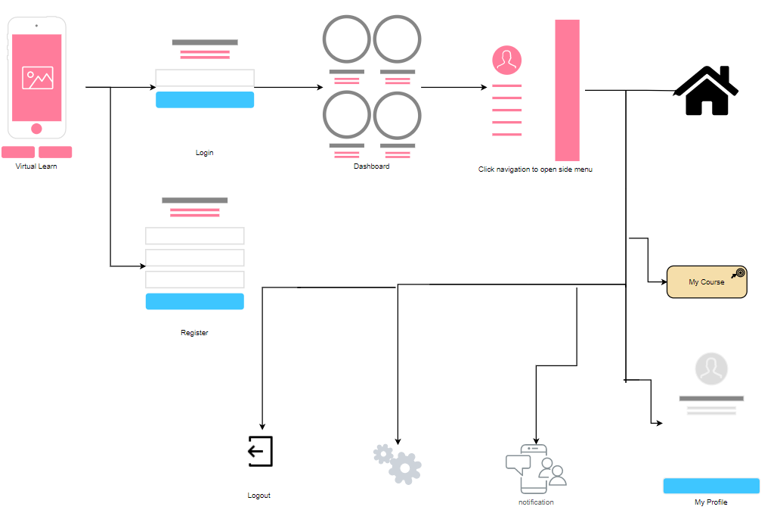
Proposed Architecture

Slide 14
Methodology
Splash Screen
Create spash_screen xml file in layout.
In linear layout, create an image view.
In view part create splash_screen.kt file
setDuration() – to keep the screen for certain duration.
withEndAction – tells what the next activity should be
after certain time.

Slide 15
Methodology
Onboarding Activity
Create file onboarding_activity xml file.
Linear layout - viewPager and image View present.
Data class of onboarding items is created.
Onboarding indicator active and inactive design is created as xml file in drawable

Slide 16
Methodology
Login
Create login.xml file in layout.
Linear layout – textview, buttons (image button).
Create login_activity file in view with .kt extension.
3 cases with setOnClickListener:
Login button- home screen.
Forgot password- forgot password screen.
Register button- register screen.

Slide 17
Methodology
Registration
There are 2 parts : register screen and register success
Register screen: setOnClickListener, check the phone number is in valid range.
If so, next activity will be verify account started with startActivity.
If not so, toast() – invalid range popup for some time.

Slide 18
Methodology
Register Success: appears when the registration is successful
Success.xml file contains imageView, textView etc
Success.kt file will create action upon clicking with help of setOnClickListener to go to the login activity.

Slide 19
Methodology
Forgot password
Create xml file in layouts having textview , button, imageview.
Create kt file to perform action, upon clicking button,setOnClickListener – go to verification activity.
Verification activity kt file will have link to new password activity and then password change activity .

Slide 20
Methodology
Menu
Five fragments are created.
Home fragment
My course fragment
Notification fragment
Settings fragment
My profile fragment
For dynamic list of chapters recycler view is used.

Slide 21
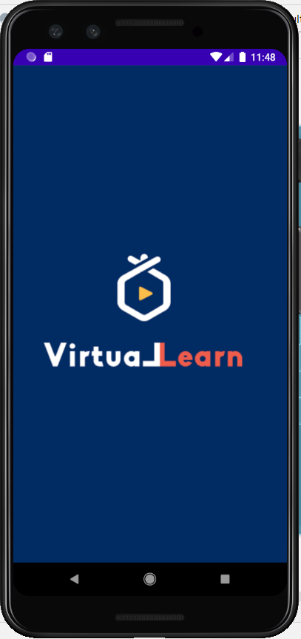
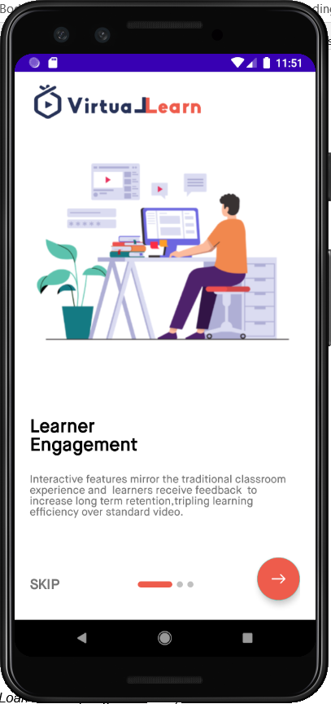
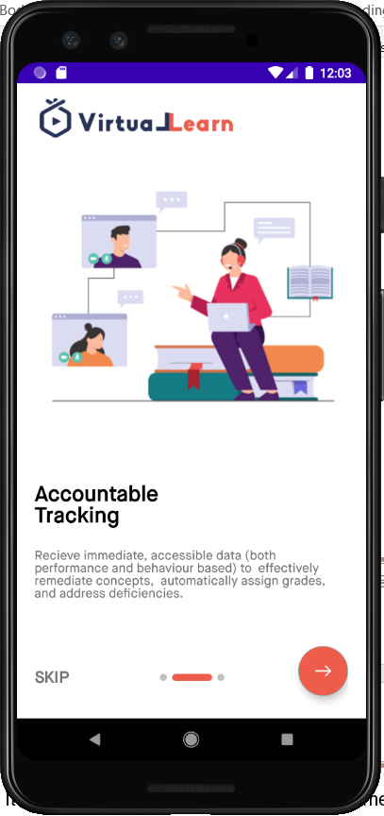
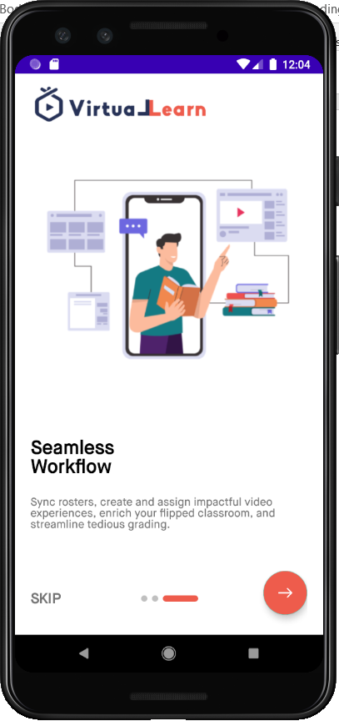
Results
Splash and Onboarding
Fig 1:Splash Screen
Fig 2: Onboarding Screens

Slide 22
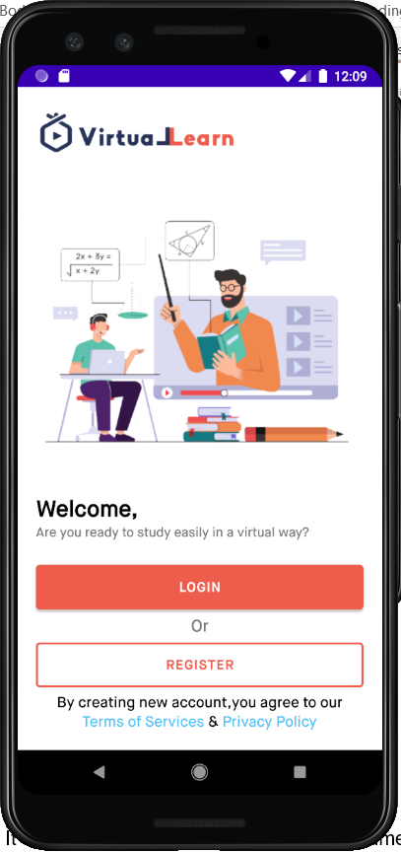
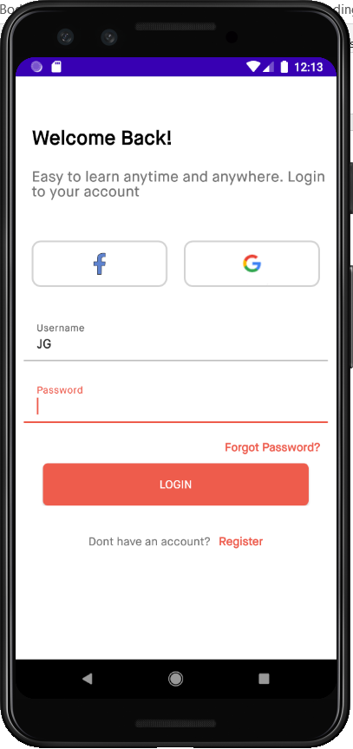
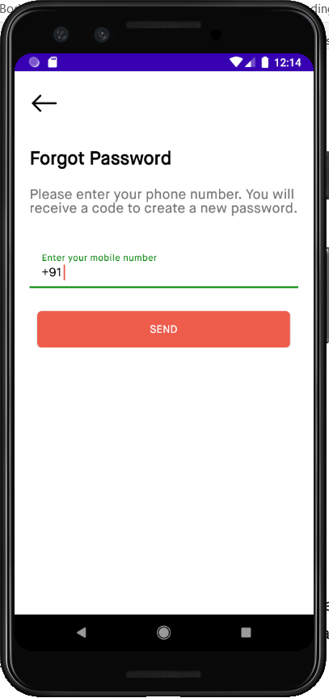
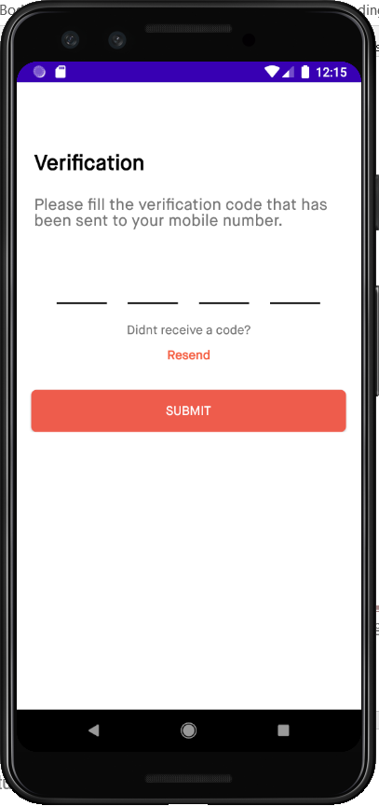
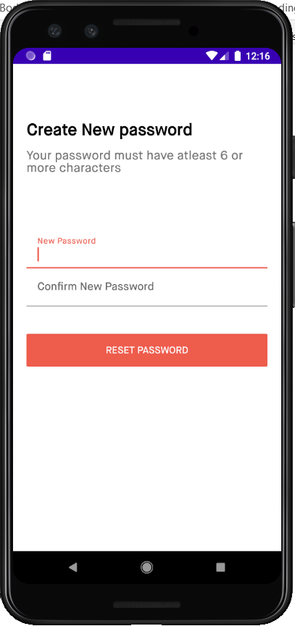
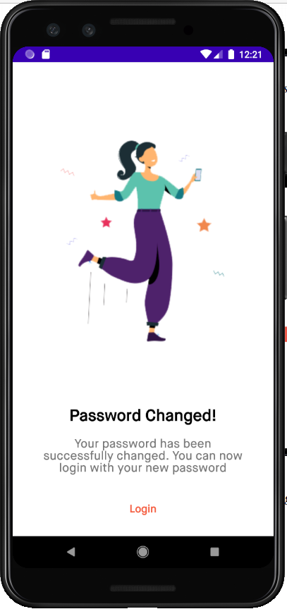
Results
Login and Registration
Fig 3: Login
Fig 4: Forgot Password

Slide 23
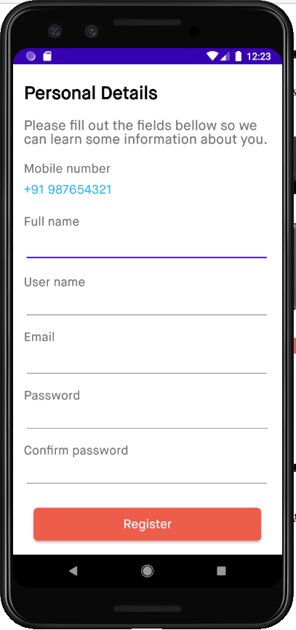
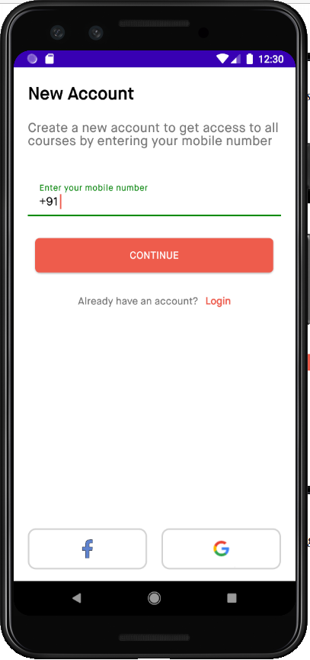
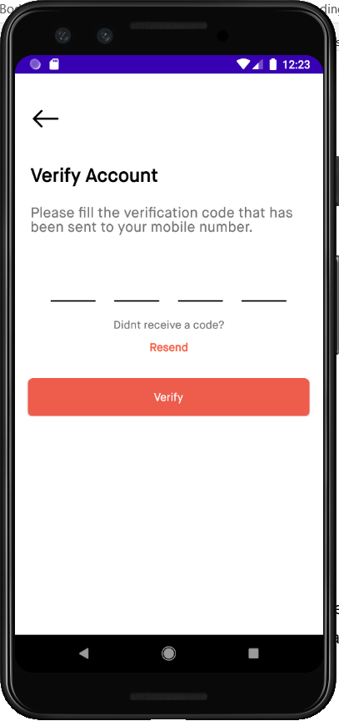
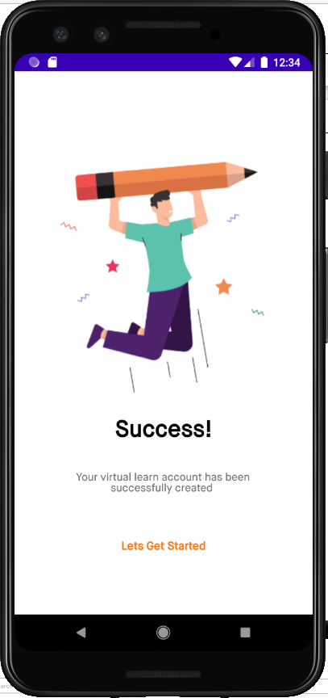
Results
Fig 5: Register

Slide 24
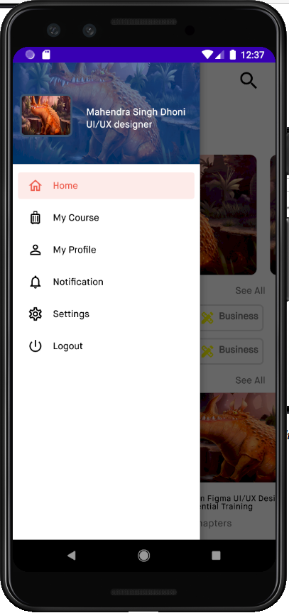
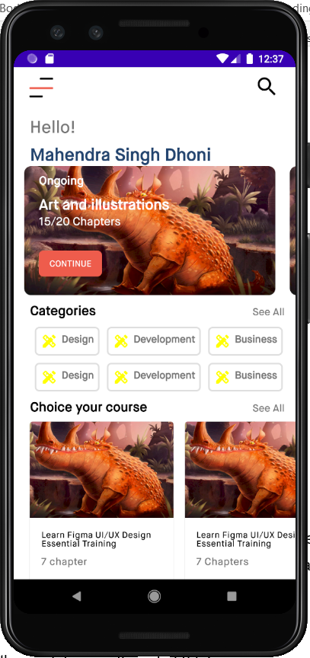
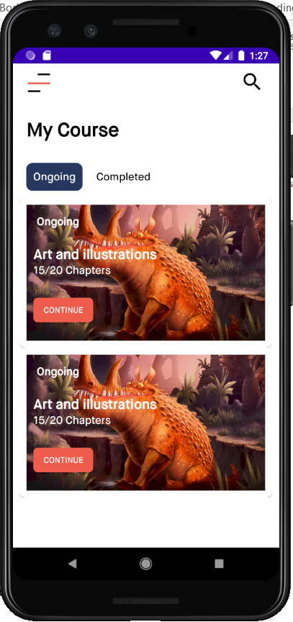
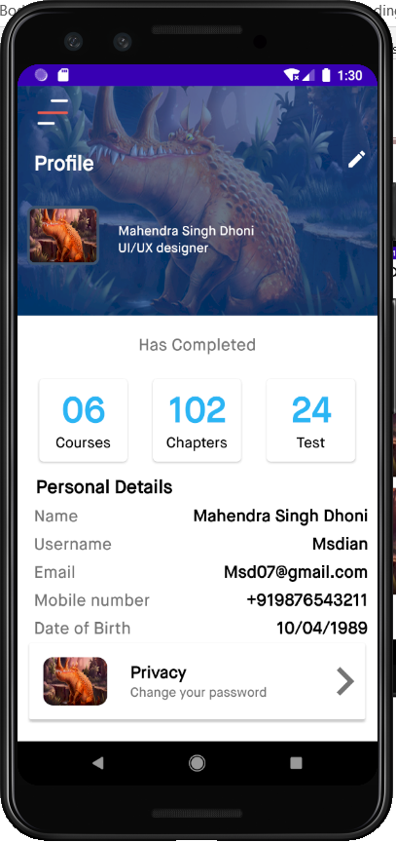
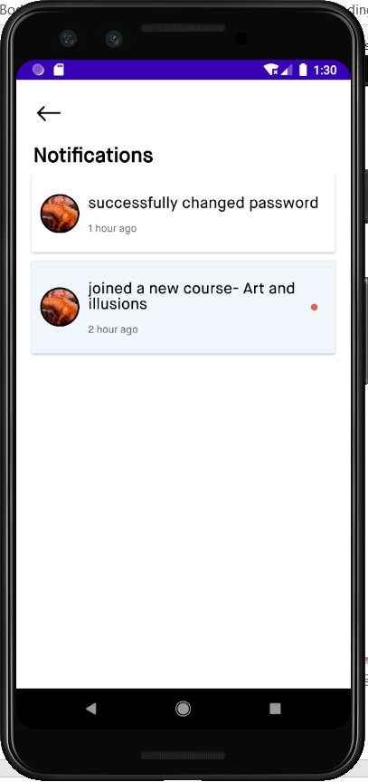
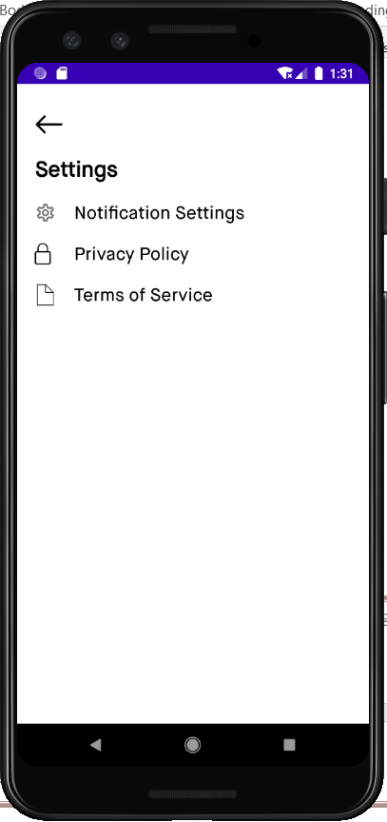
Results
Menu
Fig 6: Images contain menu and the screens upon clicking each option

Slide 25

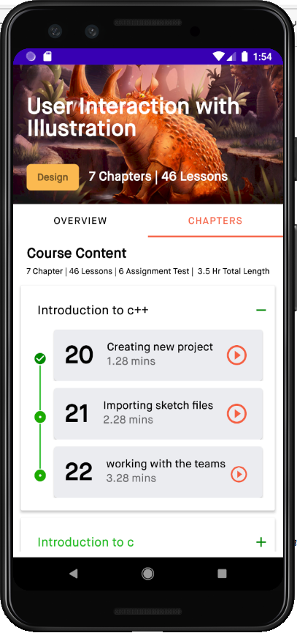
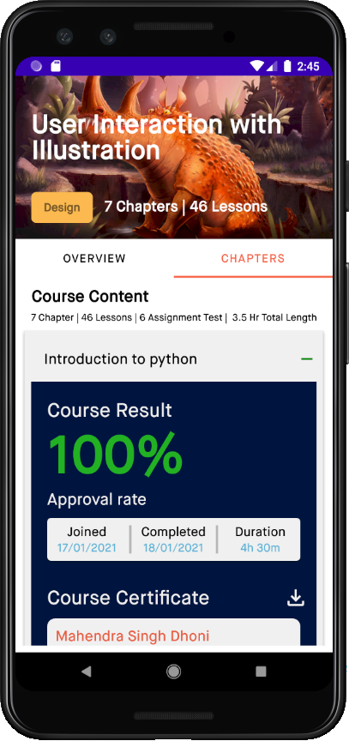
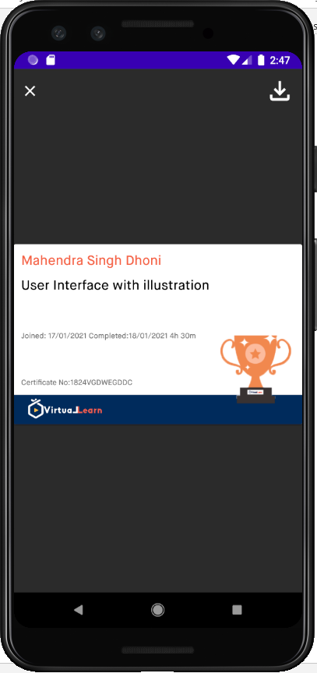
Results
My Course

Slide 26
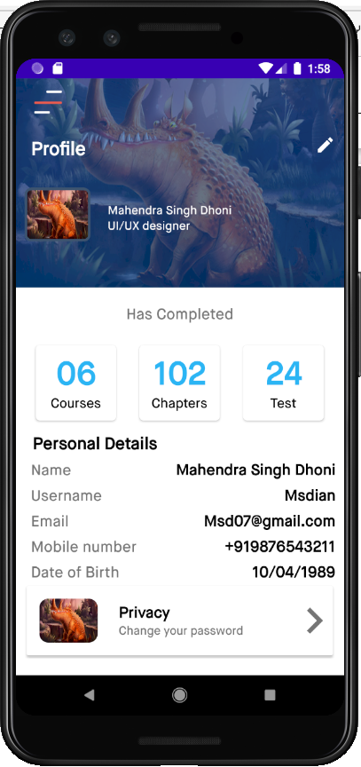
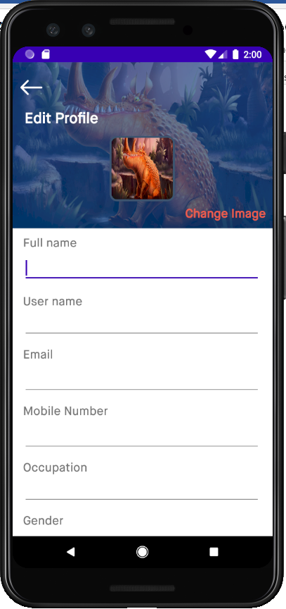
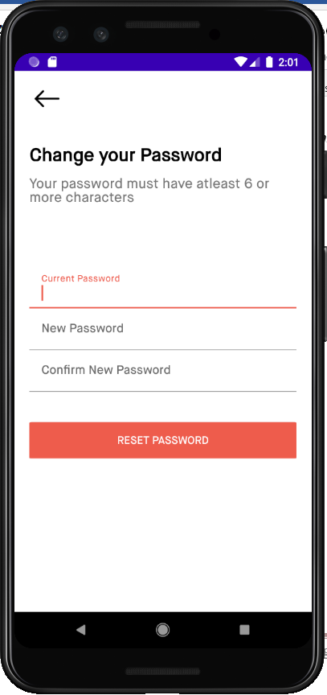
Results
My Profile

Slide 27
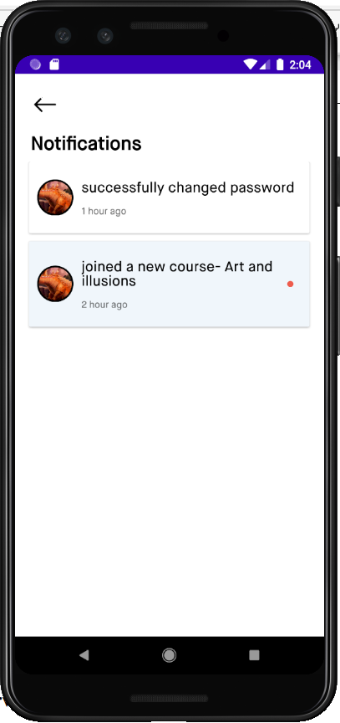
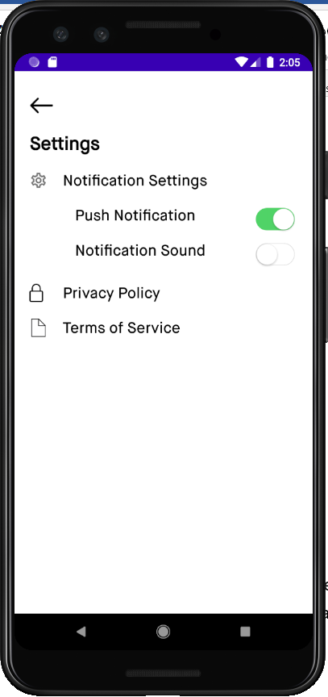
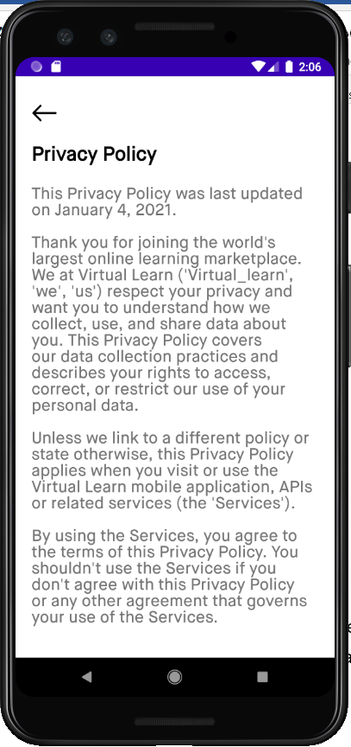
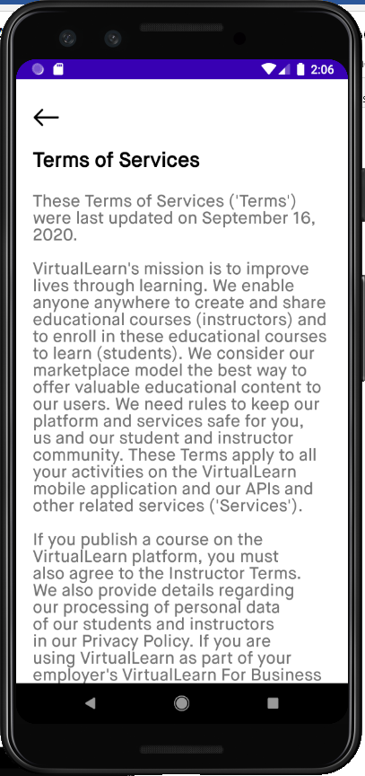
Results
Notification and Settings
Fig 7: Notification
Fig 8: Settings

Slide 28
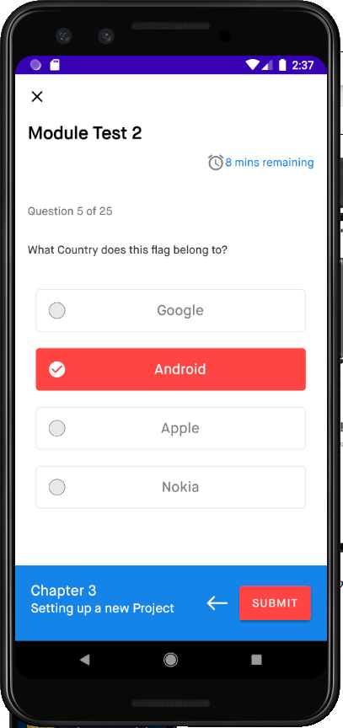
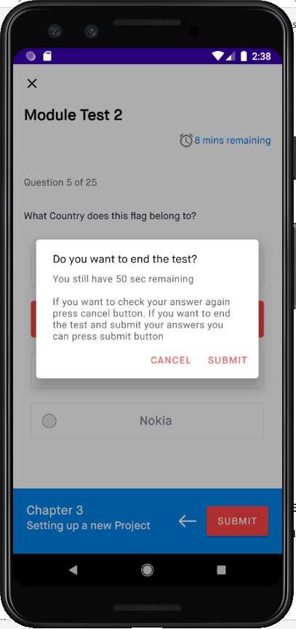
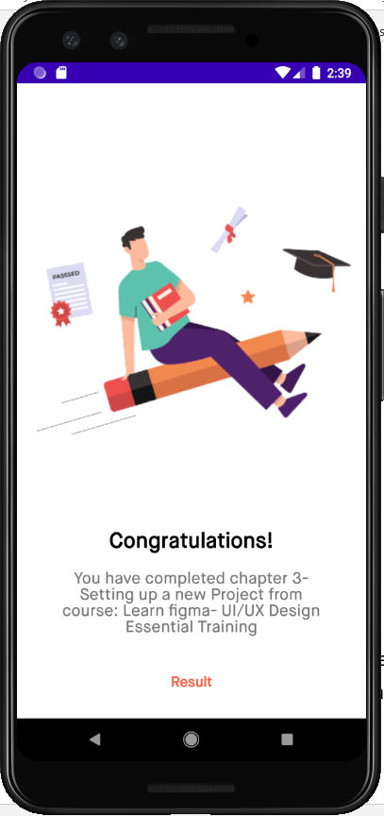
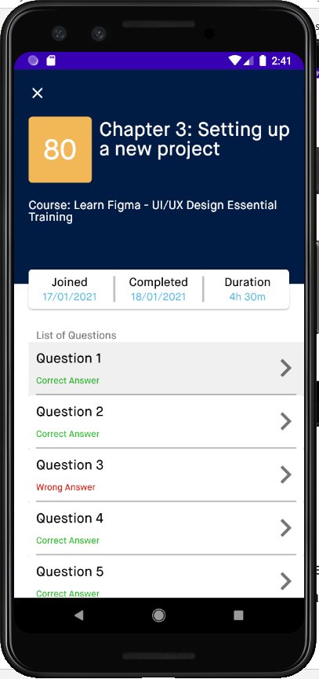
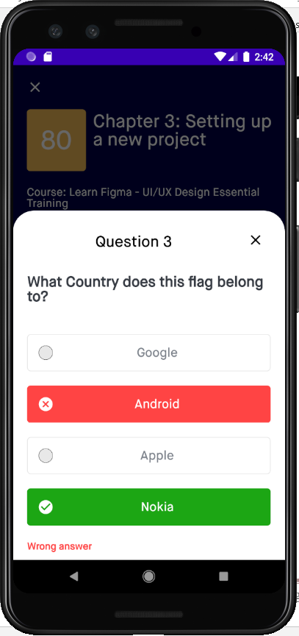
Results
Test

Slide 29
Future work to be implemented
We want to focus more on making the app more user-friendly and appealing to the learners of smaller ages to find the process more fun and engaging.
Web application for our model which is a better platform for interaction and each user can browse in their phones for flexible use.

Slide 30
Conclusion
Developed virtual learning android application.
Quiz is conducted in between the courses which helps to understand the amount of knowledge they have gained.
Access lessons of their chapters of interest .

Slide 31
References
Dionisia Laranjeiro,“Development of Game-Based M-Learning Apps for Preschoolers”, 2021
N A Handoyono and Rabiman,“ Development of android-based learning application in EFI materials for vocational schools”,2020
A D Achmad, A Achmad, and Z M Putra, “Interactive Learning Media Based on Android for Computer Programming Course”,2020
Nia Gracelita, “Development of e-learning and statistical simulation for explorative data analysis based on android”,2020

Slide 32
References
Surya Pratama and Adi Jaya Putra,”Developing Android Based English Vocabulary Learning Materials for Primary School Students”,2020
L. Rivas, “Development and Application of an App for Virtualized Learning of Scientific and Medical Terminology”,2018
Y Roza, S N Siregar, S Salam and A Adnan, “Android based e-learning tutorial for mathematics teachers”,2018
Muzayyanna, Riswandi, Helmi, Akla, “Application Based Android As A Development Of English Learning Media”,2018

Slide 33
THANK YOU

